Slide 1


Slide 2
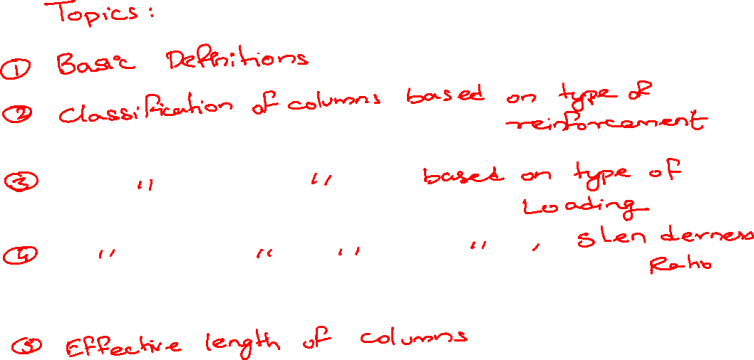

Slide 3
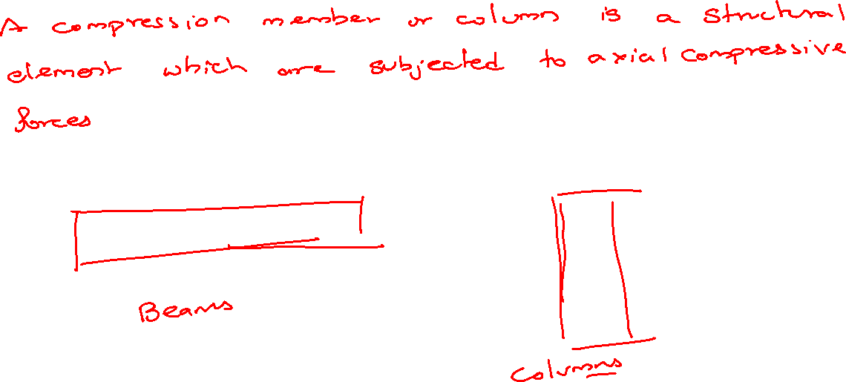

Slide 4
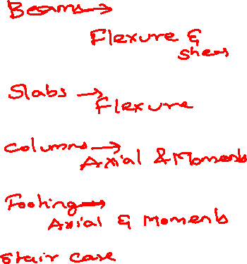

Slide 5
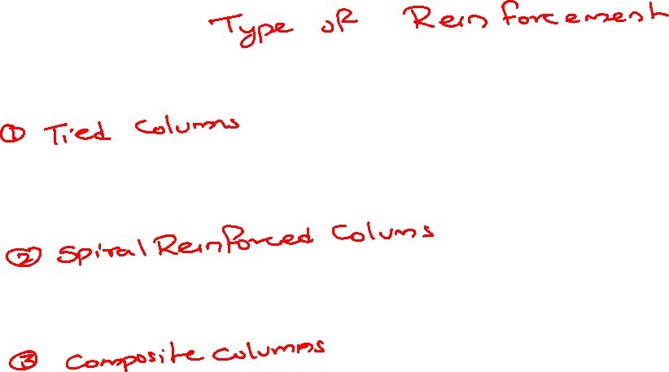
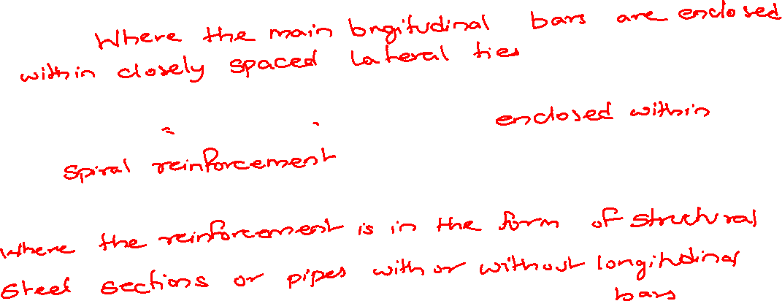

Slide 6
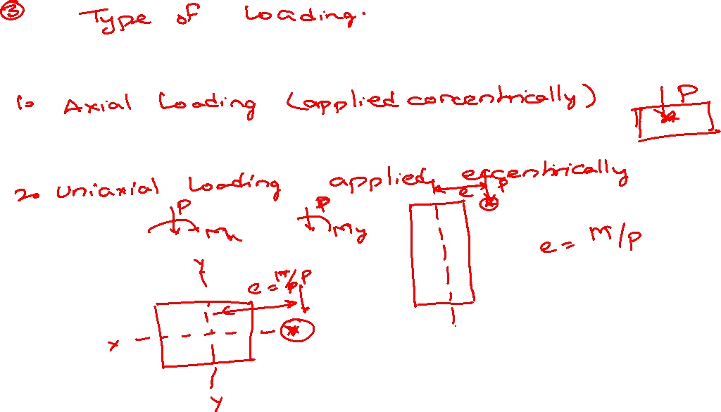

Slide 7
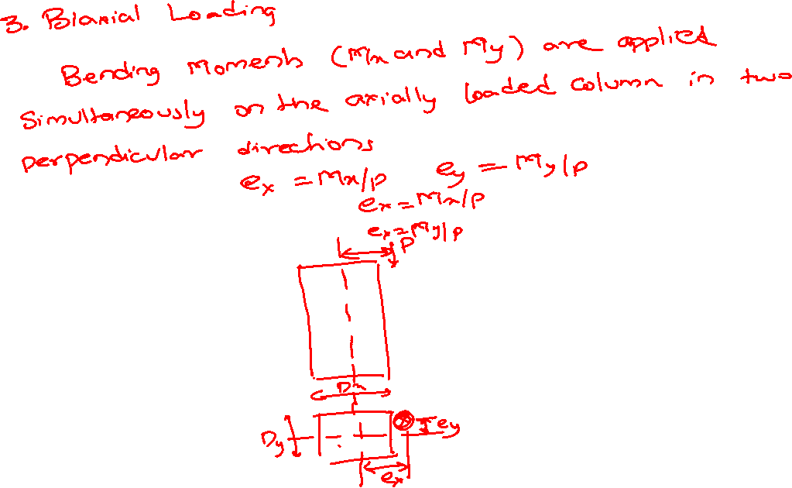

Slide 8
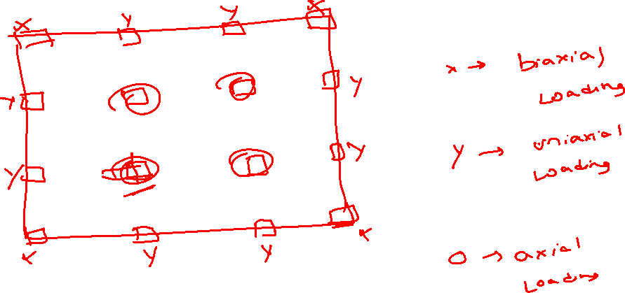

Slide 9


Slide 10
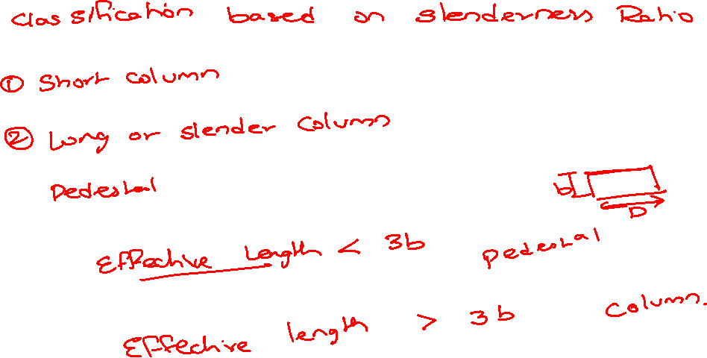

Slide 11
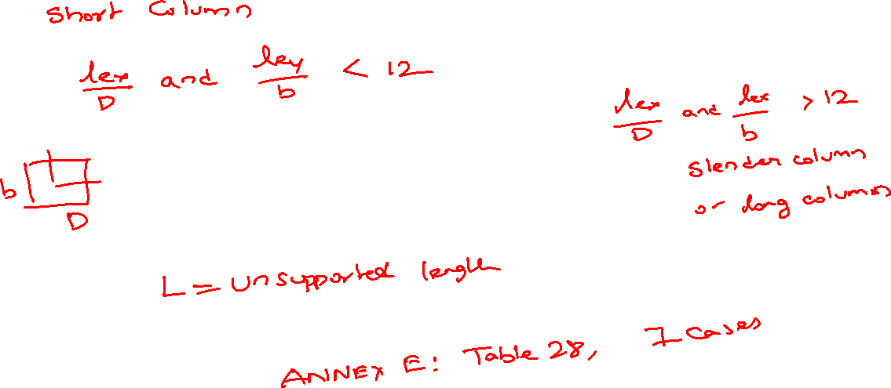

Slide 12
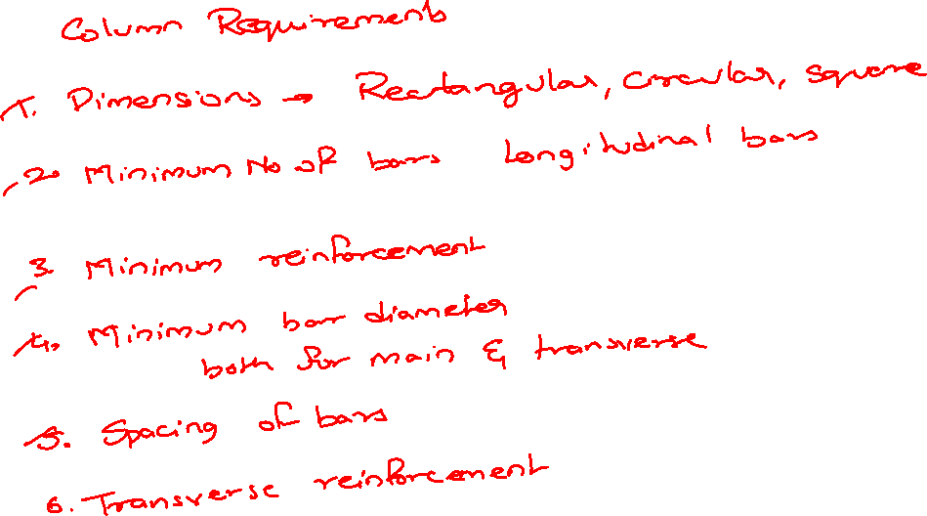

Slide 14

ASSUMPTION
PLANE SECTION NORMAL TO THE AXIS REMAIN PLANE AFTER BENDING.
THE MAXIMUM STRAIN IN CONCRETE AT THE OUTERMOST COMPRESSION FIBRE IS TAKEN AS 0.0035.
THE TENSILE STRENGTH OF THE CONCRETE IS IGNORED.
THE STRESS BLOCK MAY BE ASSUMED AS RECTANGLE, TRAPEZOID, PARABOLA OR ANY OTHER SHAPE WHICH RESULTS IN PREDICTION OF STRENGTH IN SUBSTANTIAL AGREEMENT WITH THE RESULTS OF THE TEST.

Slide 15
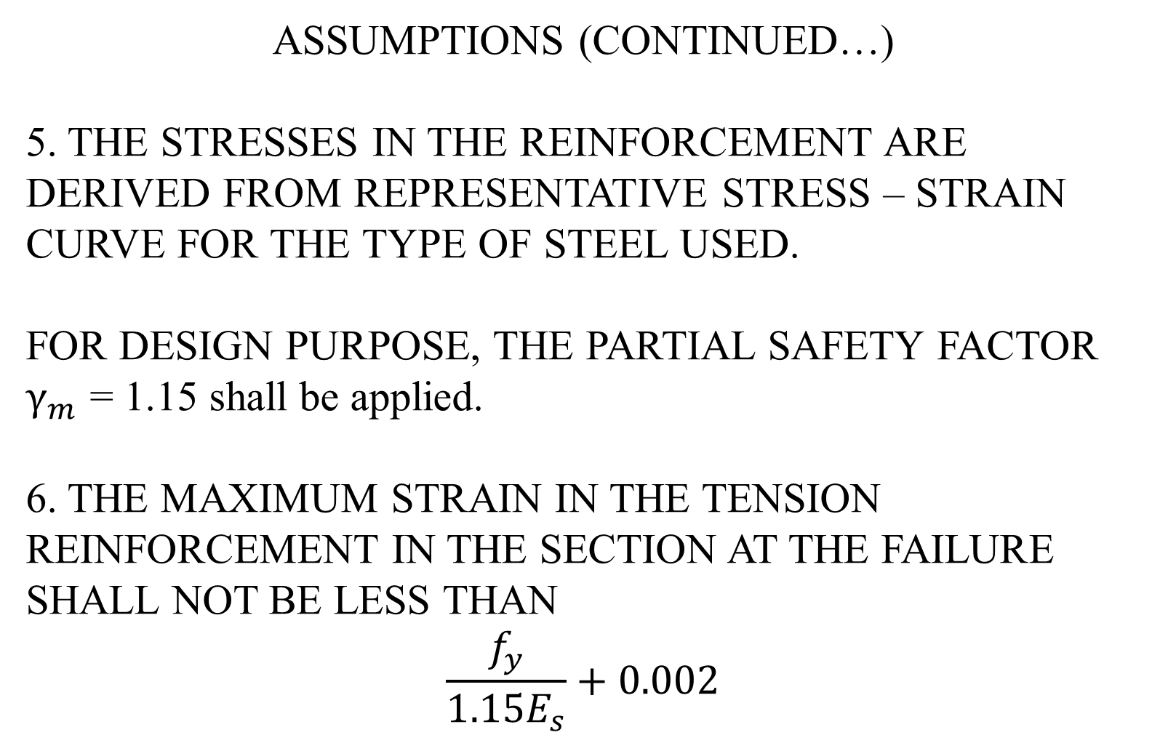

ASSUMPTIONS (CONTINUED…)
5. THE STRESSES IN THE REINFORCEMENT ARE DERIVED FROM REPRESENTATIVE STRESS – STRAIN CURVE FOR THE TYPE OF STEEL USED.
FOR DESIGN PURPOSE, THE PARTIAL SAFETY FACTOR
$γ_{m}$ = 1.15 shall be applied.
6. THE MAXIMUM STRAIN IN THE TENSION REINFORCEMENT IN THE SECTION AT THE FAILURE SHALL NOT BE LESS THAN
$$\frac{f_{y}}{1.15E_{s}}+0.002$$

Slide 16

Specially for limit state of collapse : compression
The maximum compression strain in concrete in axial compression is taken as 0.002.
The maximum compressive strain at the highly compressed extreme fibre in concrete subjected to axial compression and bending and when there is no tension on the section shall be 0.0035 minus 0.75 times the strain at the least compression fibre.

Slide 17
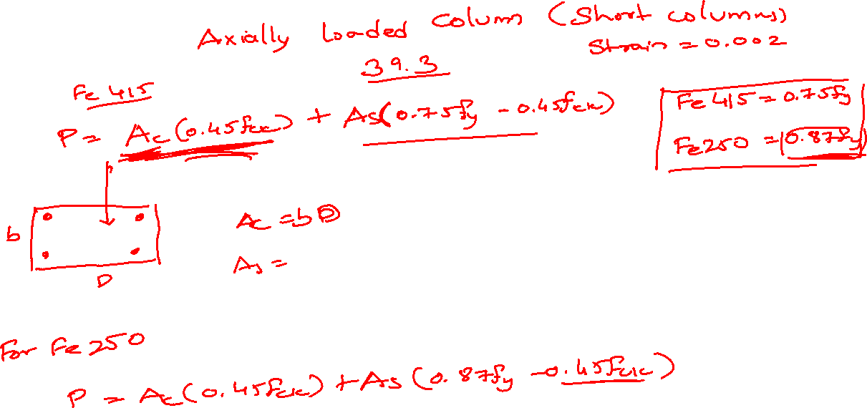

Slide 18
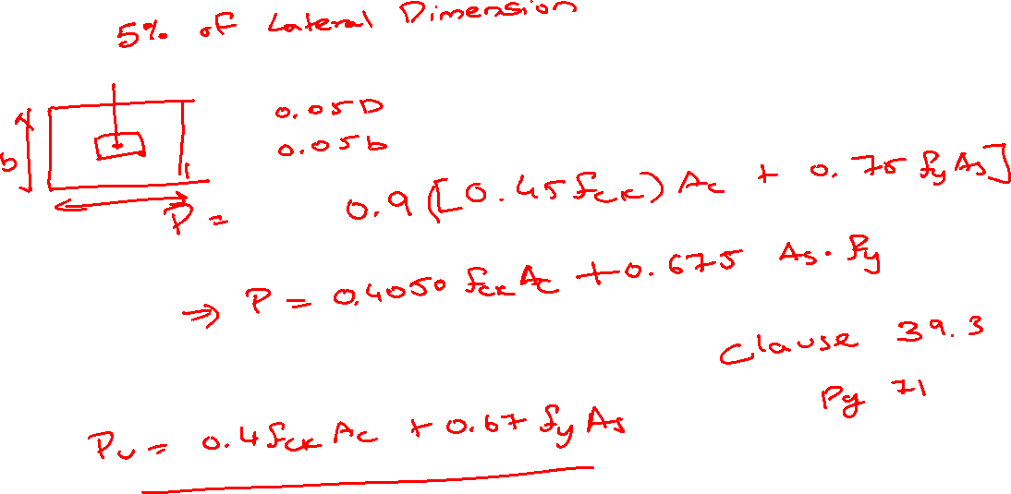

Slide 19

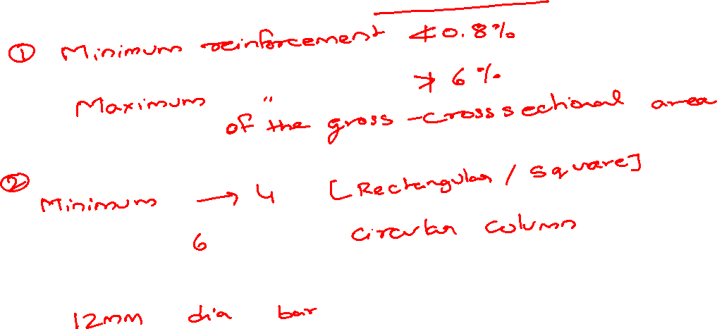

Slide 20
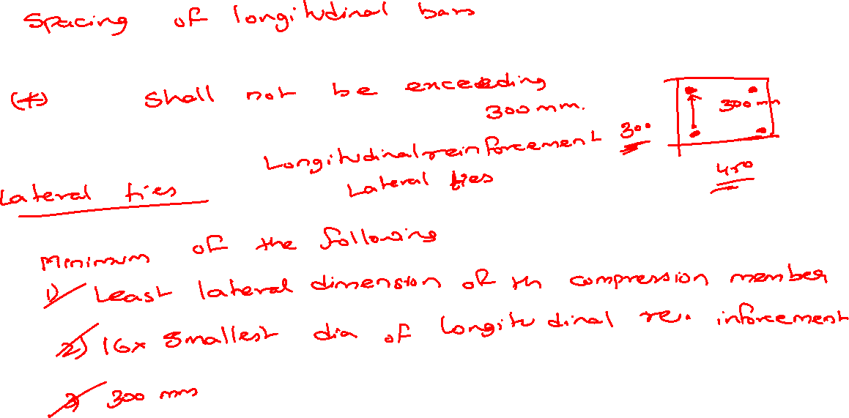

Slide 22
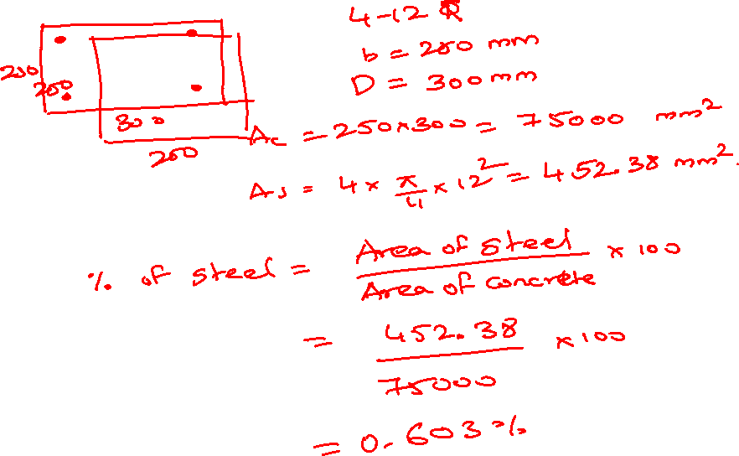

Slide 23
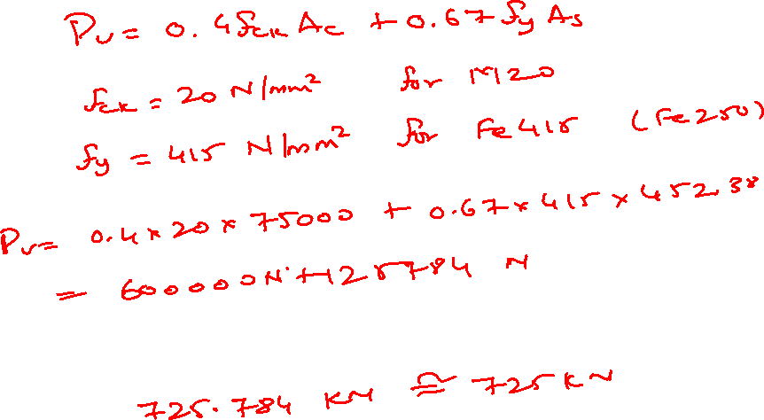

Slide 24
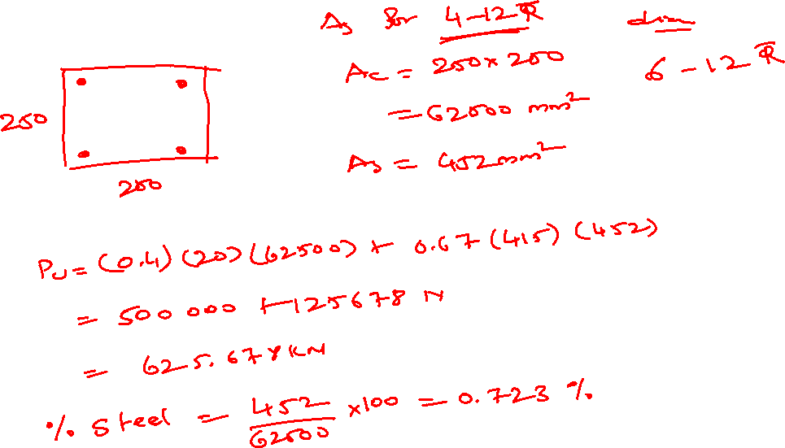

Slide 25
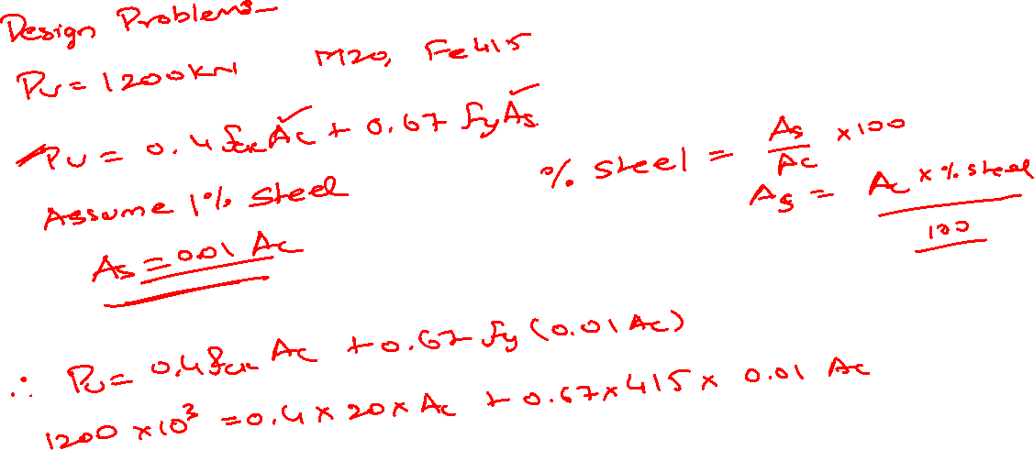

Slide 26
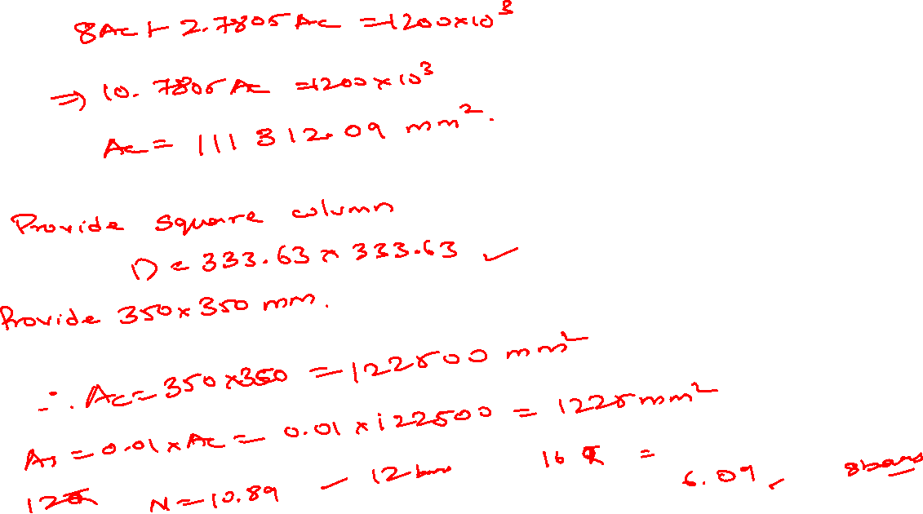

Slide 27
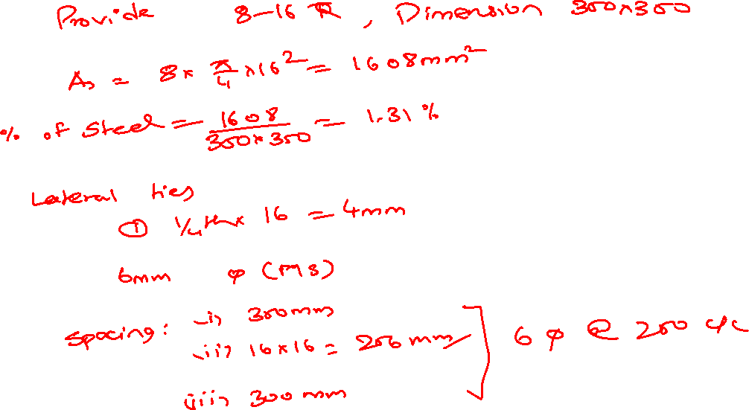

Slide 28
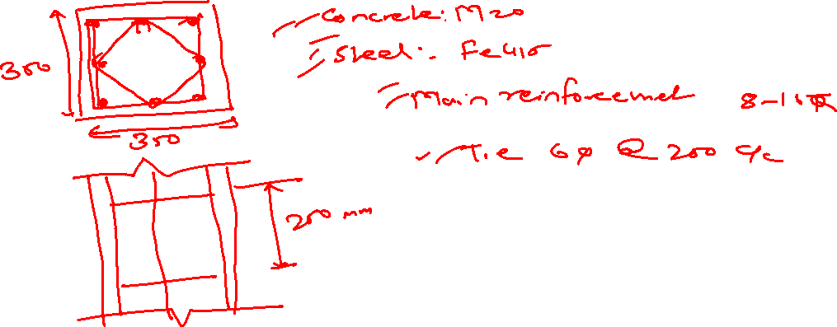

Slide 29
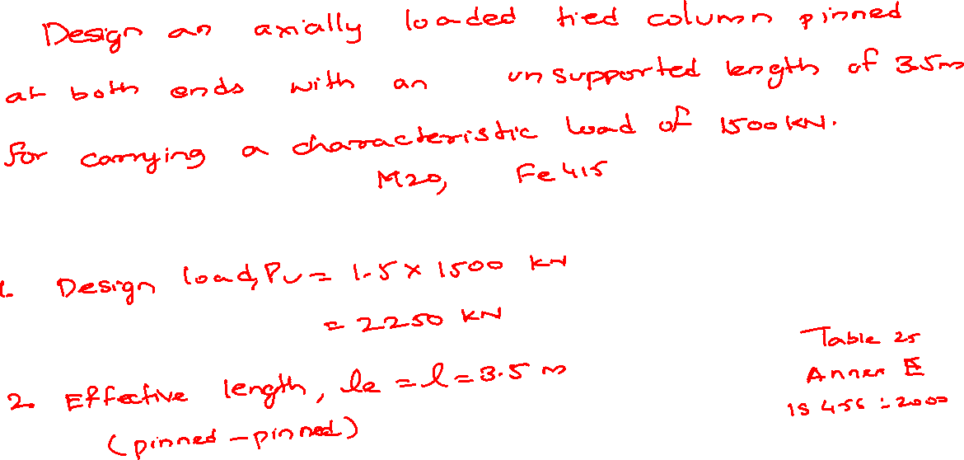

Slide 30
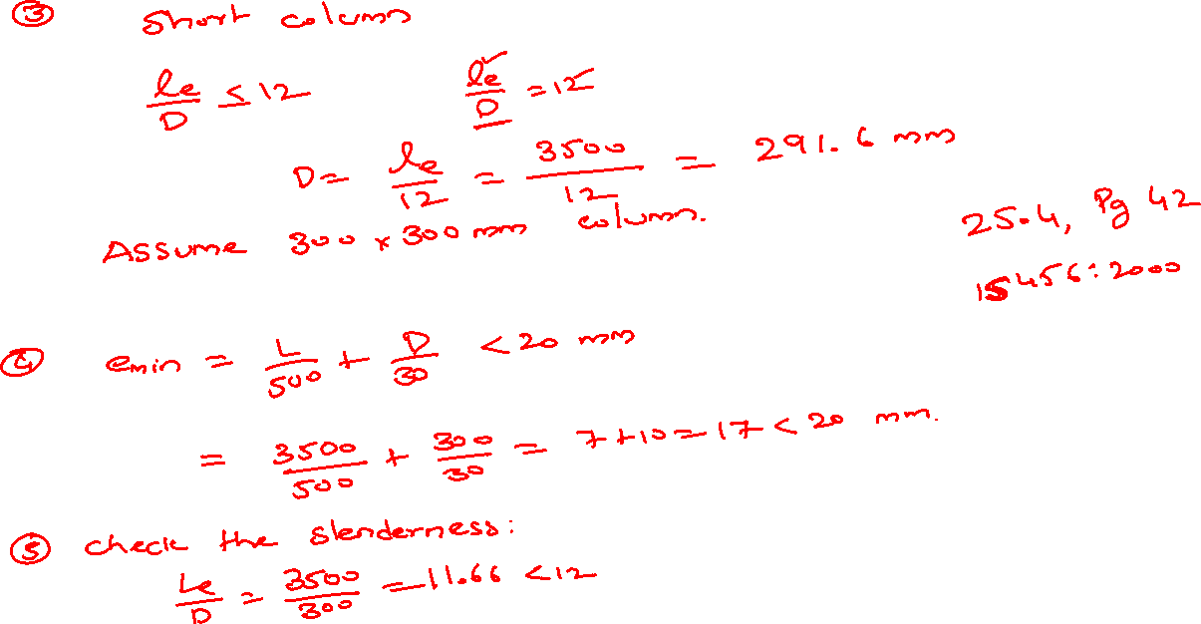


Slide 31
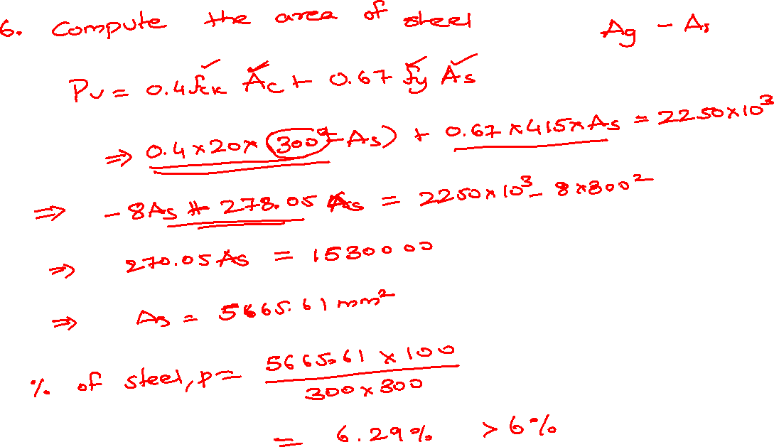

Slide 32
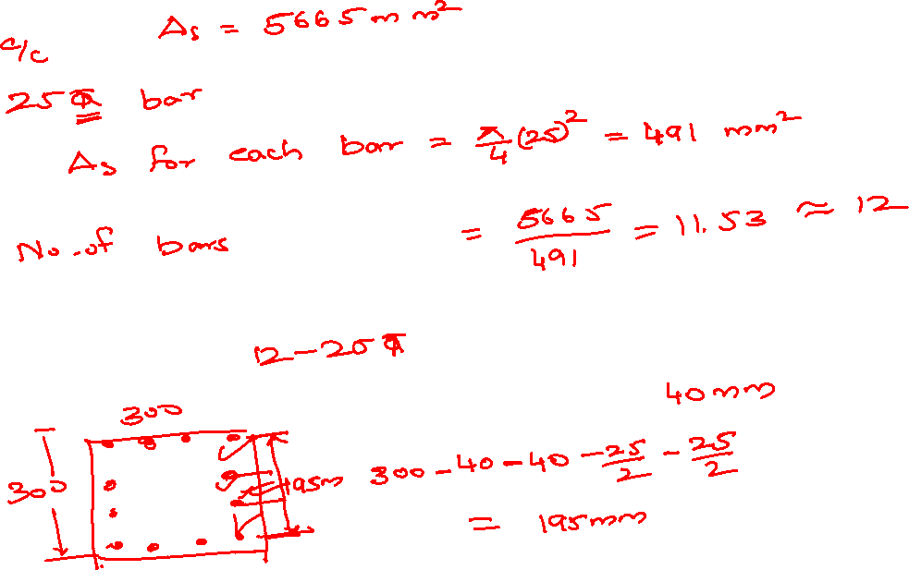

Slide 33
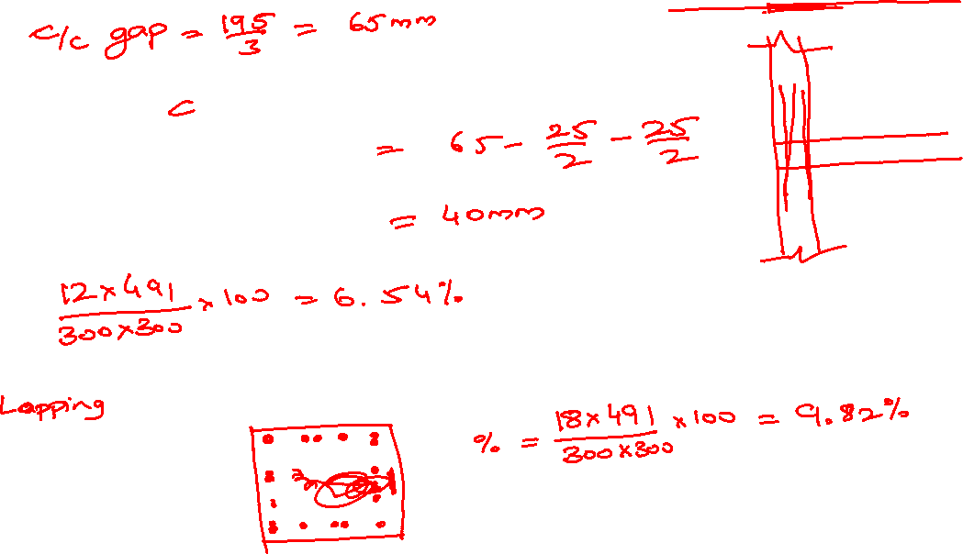

Slide 34
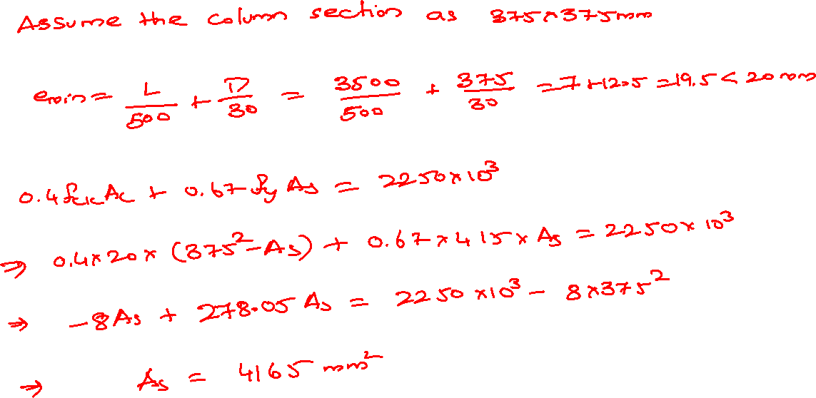

Slide 35
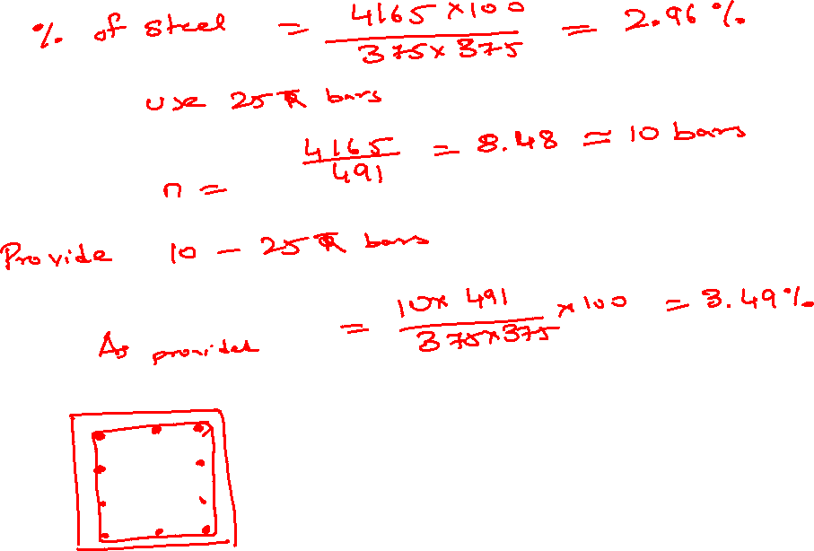

Slide 36
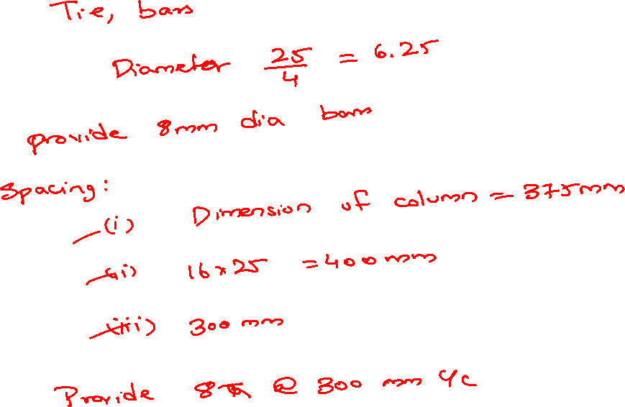

Slide 37
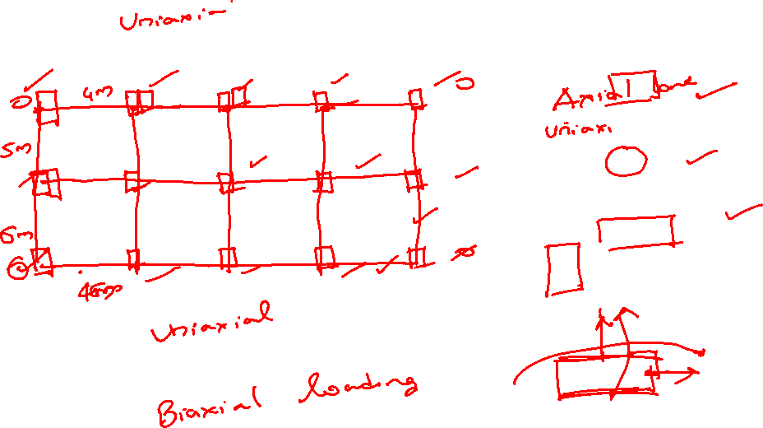

Slide 38
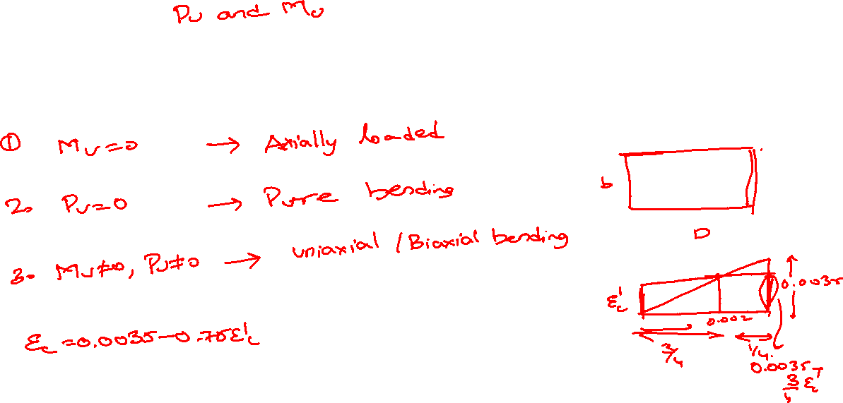

Slide 39
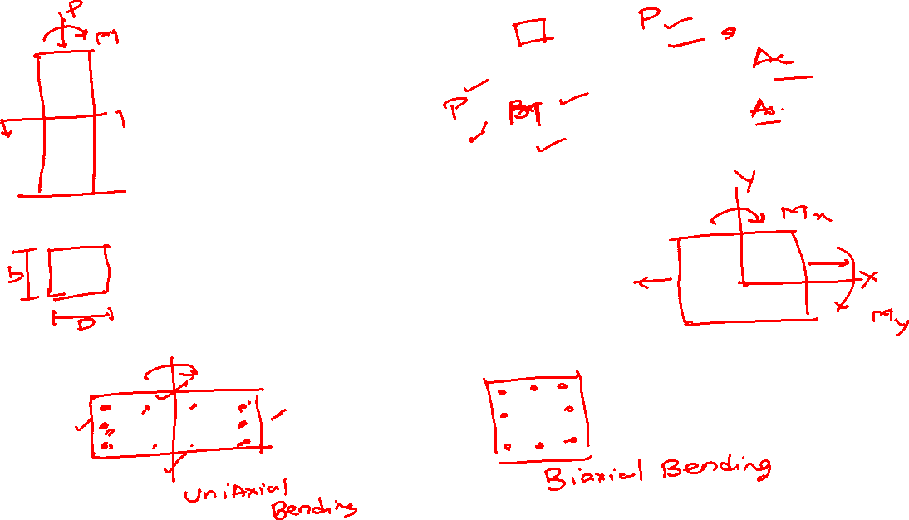

Slide 40
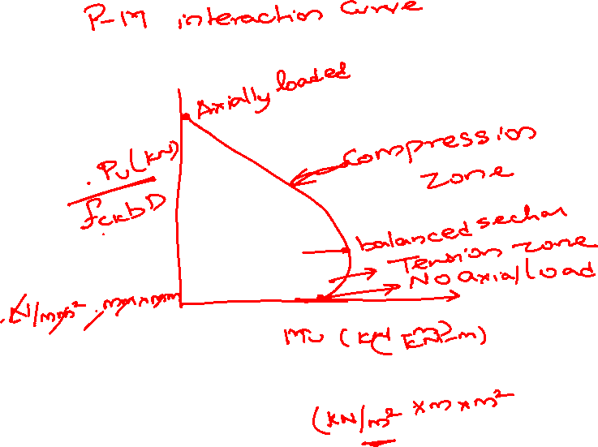

Slide 41
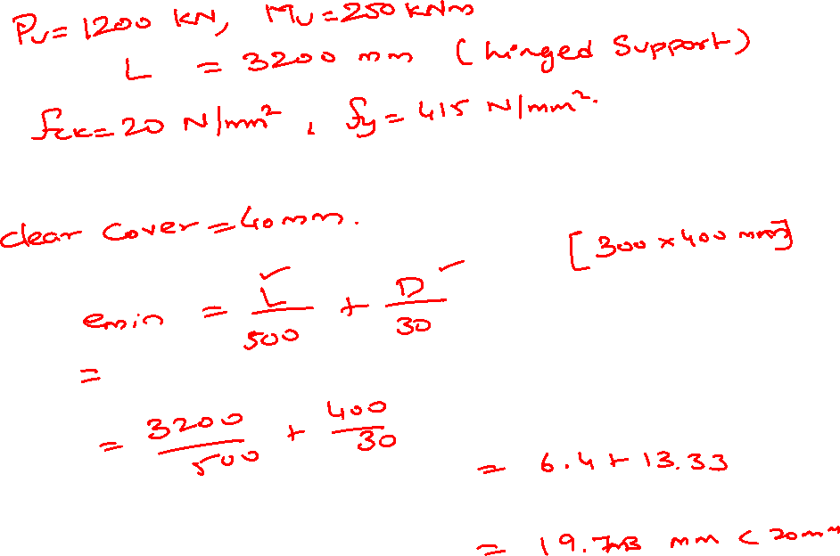

Slide 42
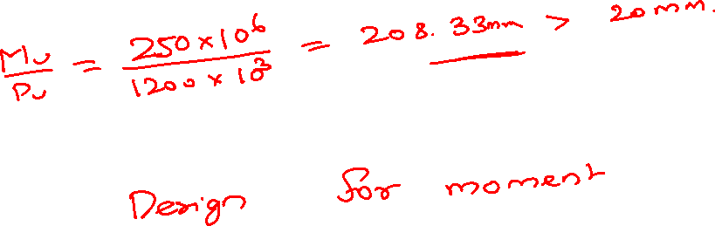

Slide 43
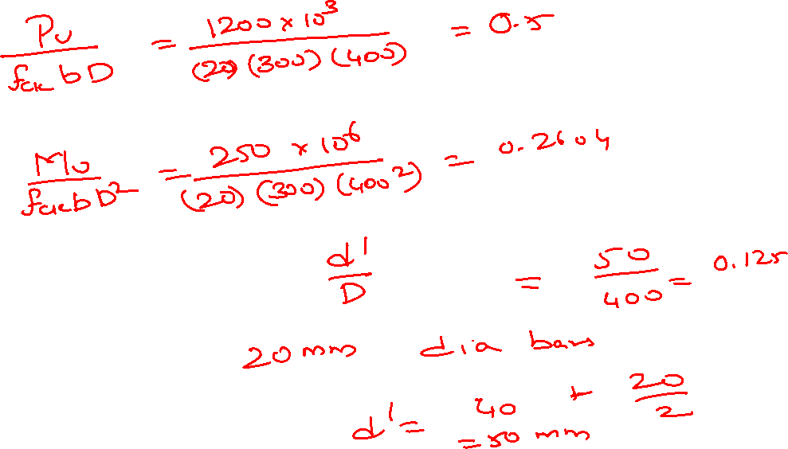

Slide 44
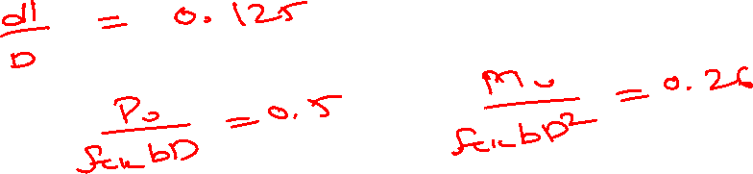
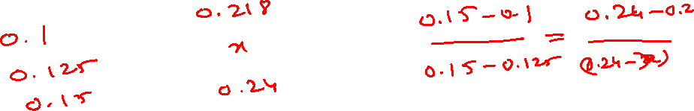
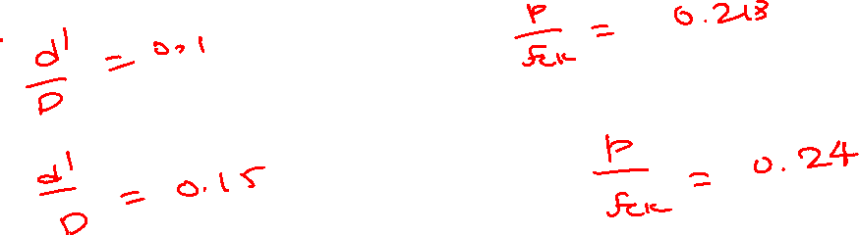

Slide 45
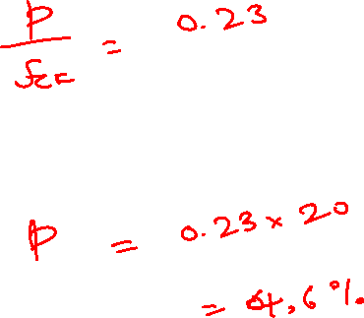

Slide 46
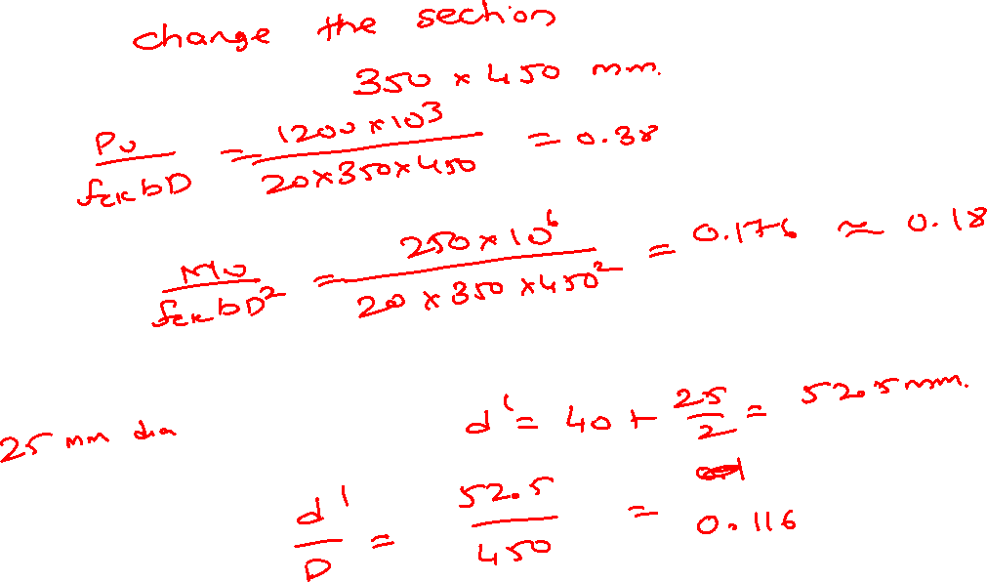

Slide 47
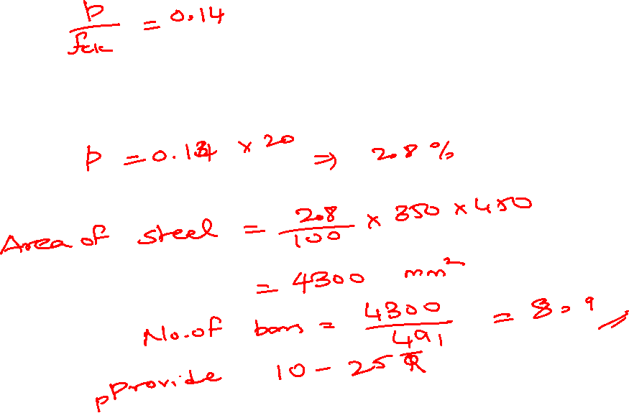

Slide 48
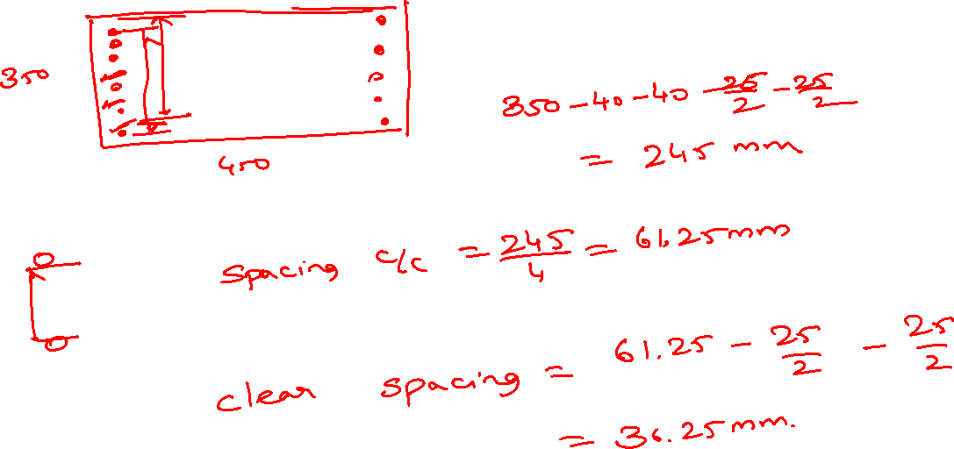

Slide 49

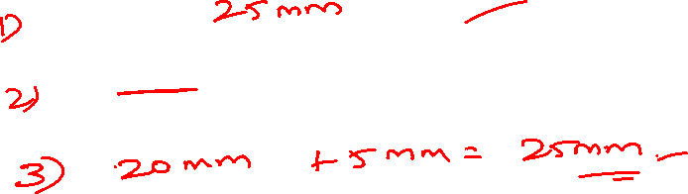

Slide 50
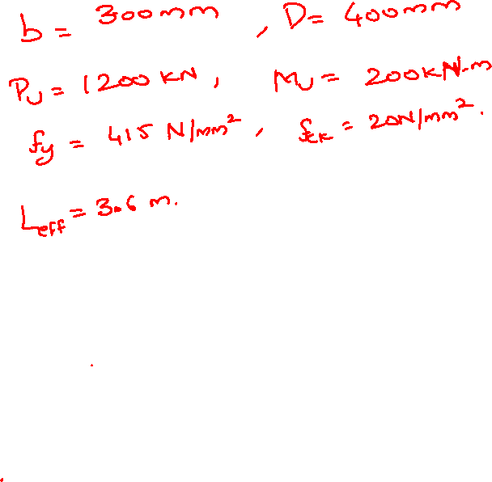
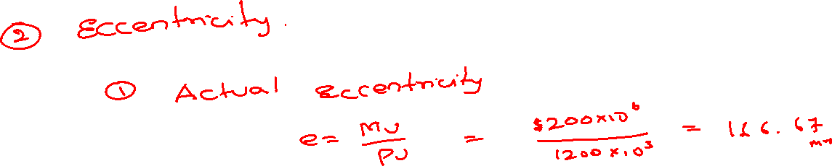
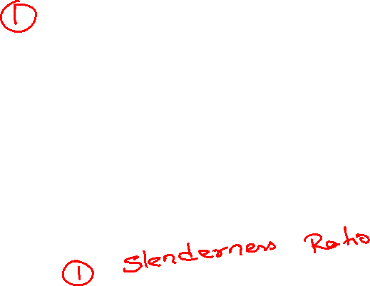

Slide 51
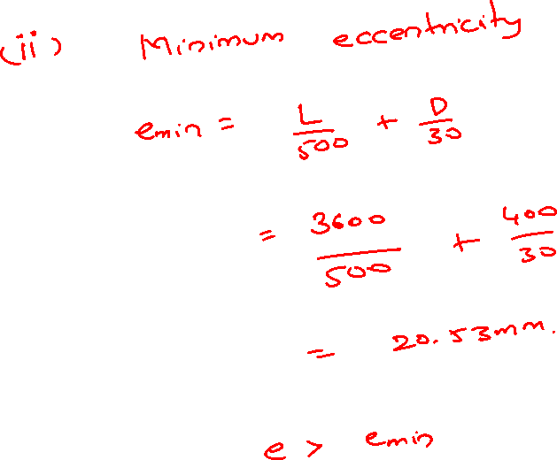

Slide 52


Slide 53


Slide 54



Slide 55


Slide 56




Slide 57


Slide 58


Slide 59


Slide 60


Slide 61


Slide 62


Slide 63


Slide 64


Slide 65



Slide 66



Slide 67


Slide 68


Slide 69


Slide 70


Slide 71


Slide 72



Slide 73




Slide 74


Slide 75



Slide 76


Slide 77


Slide 78


Slide 79


Slide 80


Slide 81




Slide 82



Slide 83



Slide 84




Slide 85


Slide 86



Slide 87


Slide 89


Slide 90



Slide 91


Slide 92



Slide 93


Slide 94


Slide 95


Slide 96



Slide 97


Slide 98



Slide 99


Slide 100


Slide 101


Slide 102



Slide 103








Slide 104


Slide 105


Slide 106


Slide 107


Slide 108


Slide 109


Slide 110


Slide 111


Slide 112


Slide 113


Slide 114


